Slide 1
Health Awareness and Nutrition
Food Safety
Department of Clinical Nutrition and Dietetics
College of Health Sciences

Slide 2
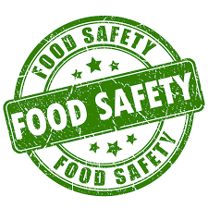
Food Safety
Food safety refers to the handling, preparation, and storage of food in ways that prevent foodborne illness.
Safe foods:
Free of health hazards
Unsafe foods:
Illness
Food poisoning
Health hazards

Slide 3
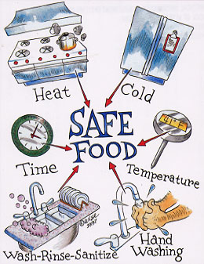
Food Safety
The aims of food safety are to:
Prevent health hazards
Raise consumer awareness about the seriousness of foodborne illness
Provide solutions for easy and safe food handling in the food institutions and our own kitchens
Assist groups at higher risk of food poisoning such as the elderly, pregnant women, infants, young children, and people with chronic disease

Slide 4
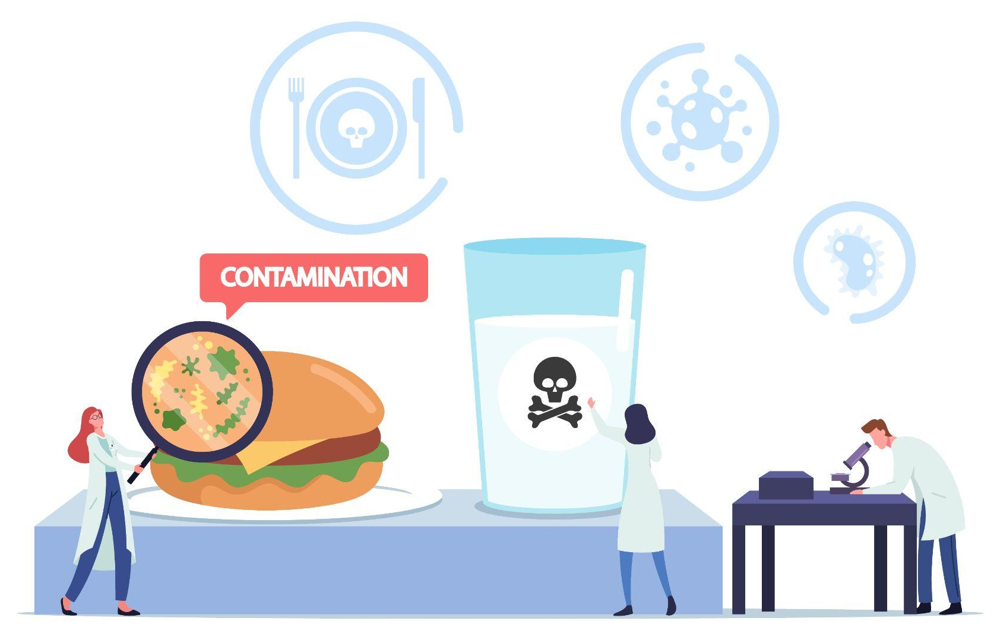
Types of Hazards
Physical hazards:
Foreign objects found in food products that enter the food item either during harvesting, transport or during processing. E.g.: Broken manufacturing equipment, broken glass, plastic shards, hair, nails, debris, dirt and metal shavings.
Chemical hazards:
Presence of harmful substances found in food naturally, or added unintentionally during processing. E.g.: Poisonous chemicals, food additives at unacceptable levels, pesticides, etc.
Biological hazards:
Contamination of food by microorganisms (bacteria, viruses and parasites).

Slide 5
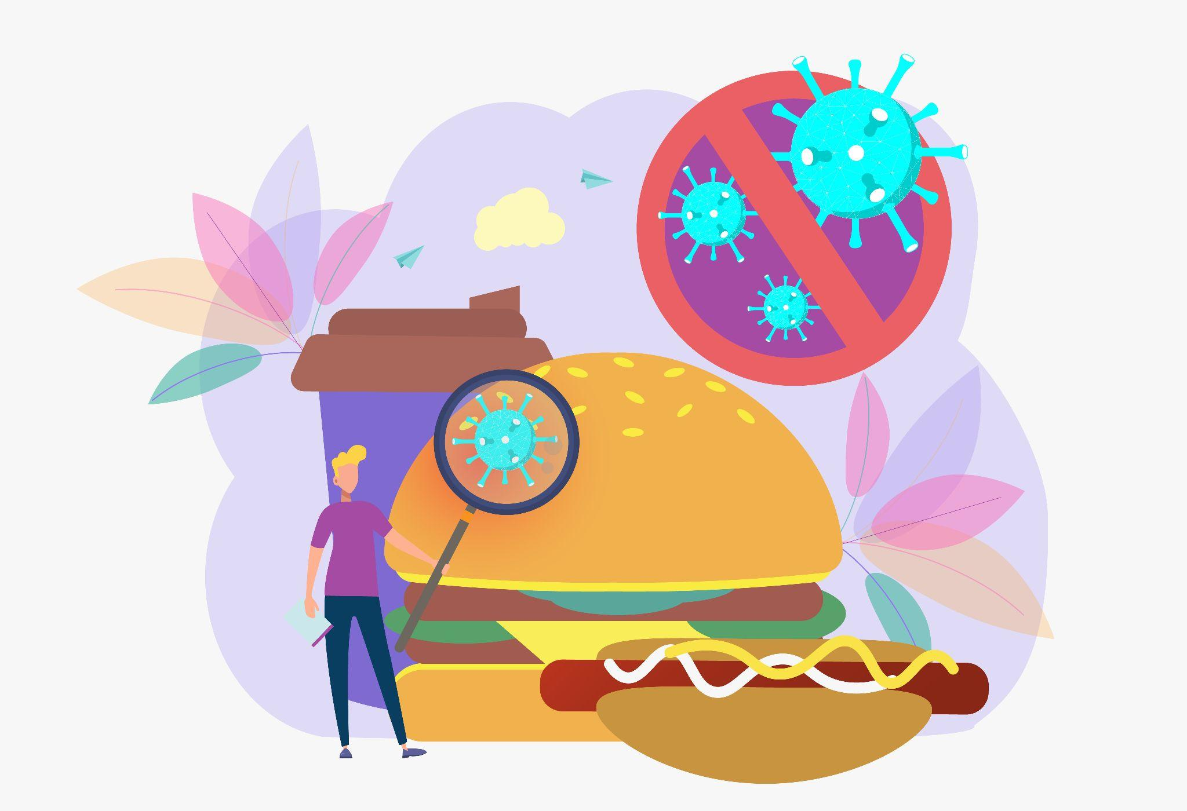
Types of Microorganisms
Microorganisms that contaminate food can be broadly classified into two types: pathogenic and non-pathogenic.
Non-pathogenic microorganisms are also referred to as spoilage causing microorganisms. They can be easily identified by the changes observed in the food product (color, texture, odor, consistency).
Pathogenic microorganism contaminated food detection is difficult. It would cause the consumer to fall sick (vomiting, diarrhea, etc.)

Slide 6
Food Safety Chain
Microorganisms can contaminate food at the following stages:
Raw Materials
Farm 🡪 Supplier 🡪 Market 🡪
Transport
Process
Receiving
Handling
Producing
Storing
Dispatch
Market
Receiving
Handling
Storing
Displaying
Consumer
Storing
Preparing

Slide 7

Foodborne Illnesses
Foodborne Illness:
Any illness resulting from the consumption of contaminated food.
Foodborne Poisoning (Outbreak):
Two or more people become sick with a similar illness (symptoms) from the consumption of the same food from the same source.
Example: 2015 SALMONELLA OUTBREAK
A Salmonella Poona outbreak that caused 907 illnesses was linked to cucumbers from Mexico. This massive outbreak affected 40 states, hospitalized 204 people, and caused 4 deaths.

Slide 8
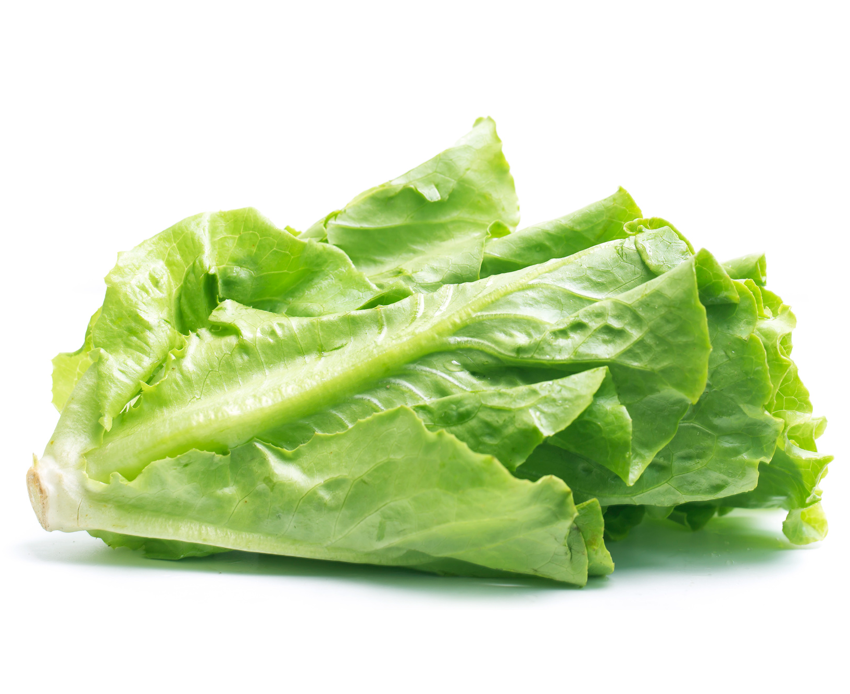
E Coli O157: H7
The 17-state outbreak began in late 2018 but did not end until February 2019. Out of 62 cases, 25 to 40 percent of patients required hospital treatment.
The investigation into this outbreak was extensive, causing FDA to “strongly recommend the entire leafy green supply chain adopt traceability best practices and state-of-the-art technology to assure quick, accurate and easy access to key data elements from farm-to-fork when leafy greens are involved in a potential recall or outbreak.”

Slide 9
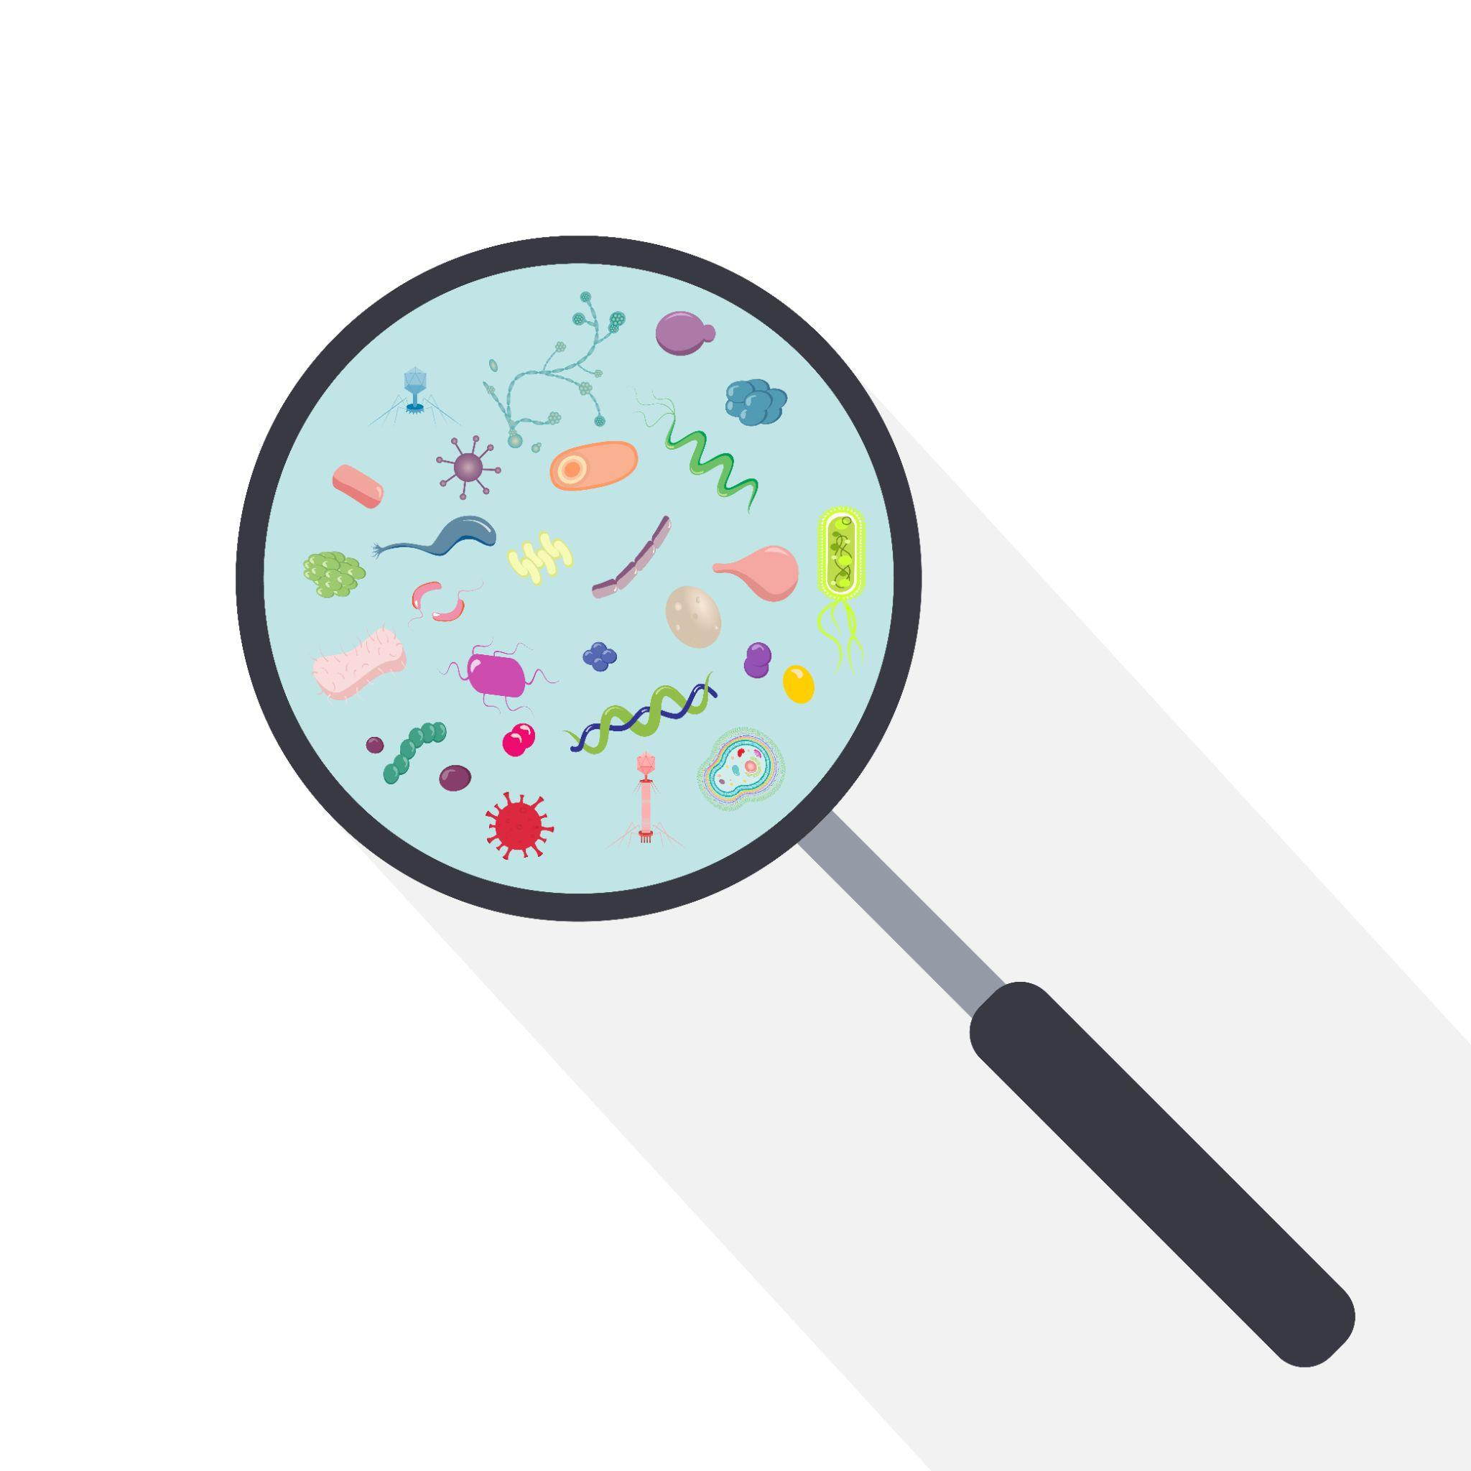
Foodborne Illnesses
Causes of foodborne illnesses:
Consumption of food/water that contain living disease-causing microorganisms (bacteria, parasite, virus) or a harmful chemical or toxin produced by bacteria.
Ingestion of toxins naturally present in many foods like mushrooms and some seafood.
Consumption of food containing toxic chemicals (contaminants) such as heavy metals and some pesticides.

Slide 10
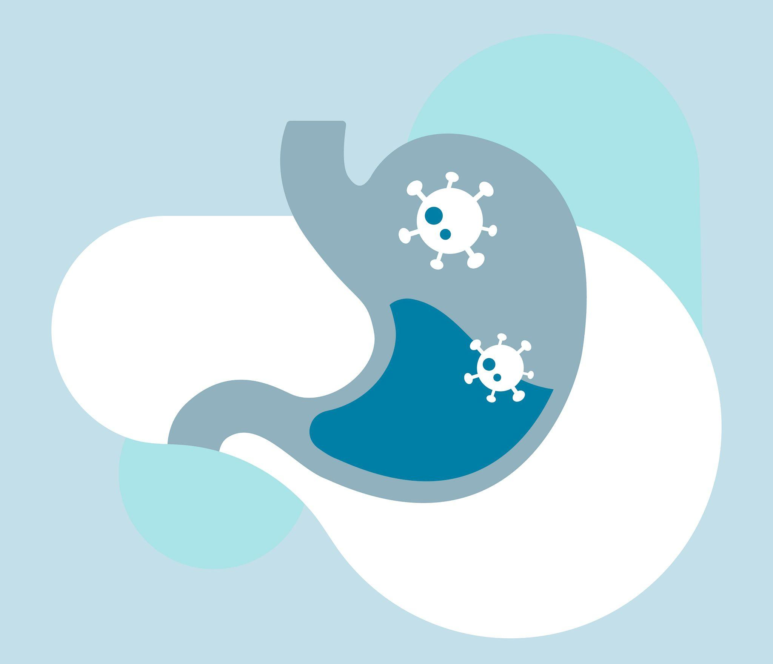
Foodborne Illnesses
How does foodborne illness occur?
Contaminated foods carry microbes into the body.
Some microbes can overcome the body’s defenses and cause infections.
It is also possible that the microorganism grows within the food item and produces toxins. Upon cooking, the microorganism may die, however, the toxins are still present within the food (some are heat resistant) which can cause illness.

Slide 11
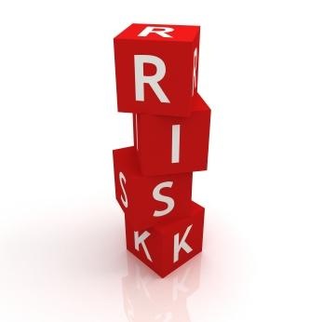
Foodborne Illnesses
Incidence of foodborne illnesses:
Ignoring necessary regulations in production and handling of foods (Safe Food Handling)
Poor personal hygiene
Temperature abuse
Cross-contamination
Poor sanitary practices

Slide 12
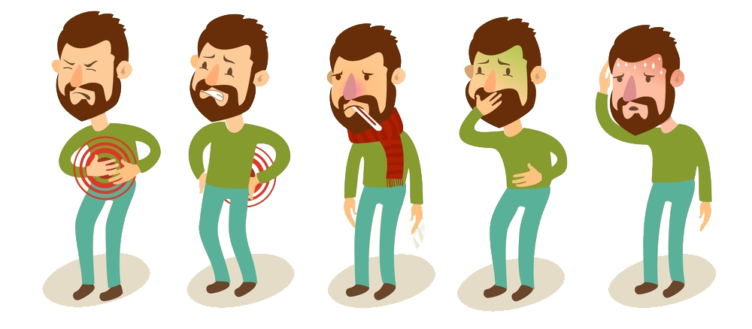
Foodborne Illnesses
What are its typical primary symptoms?
Nausea
Vomiting
Abdominal cramps
Diarrhea
Illness caused by microorganisms may have to be treated with antibiotics. However, if the illness is caused because of toxins, antibiotic therapy would be useless.
Fever
Abdominal
Pain
Diarrhea
Nausea Vomiting
Malaise
Notes:
What are its typical primary symptoms?
Nausea/ Vomiting/ Abdominal cramps / Diarrhea

Slide 13
Common Foodborne Illnesses
Illness | Symptoms | Potential Sources
Salmonella | Diarrhea, fever, abdominal cramps, vomiting | Poultry Eggs Contaminated raw foods
Listeria | Very dangerous for pregnant women, could cause premature delivery | Unpasteurized milk Soft cheeses made with unpasteurized milk
Escherichia Coli | Diarrhea, fever, abdominal cramps, vomiting | Water or food contaminated with human feces
Clostridium Botulinum | Double vision, blurred vision, drooping eyelids, slurred speech, difficulty swallowing, dry mouth | Canned foods/honey (infants)
Norovirus | Diarrhea, vomiting, nausea, and stomach pain | Shellfish, ready-to-eat foods

Slide 14
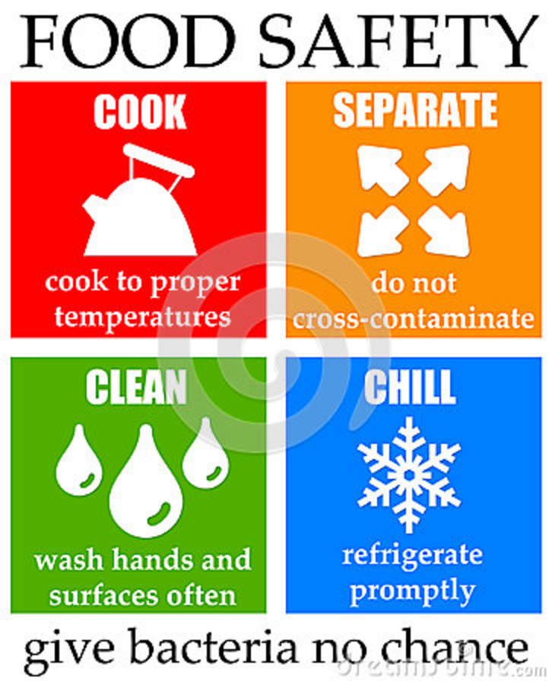
Key Recommendations
To avoid microbial foodborne illness:
Separate raw and cooked, ready-to-eat foods while shopping, preparing, or storing foods.
Cook foods to a safe temperature to kill microorganisms.
Chill (refrigerate) perishable food promptly.
Clean hands, food contact surfaces, and fruits and vegetables.

Slide 15
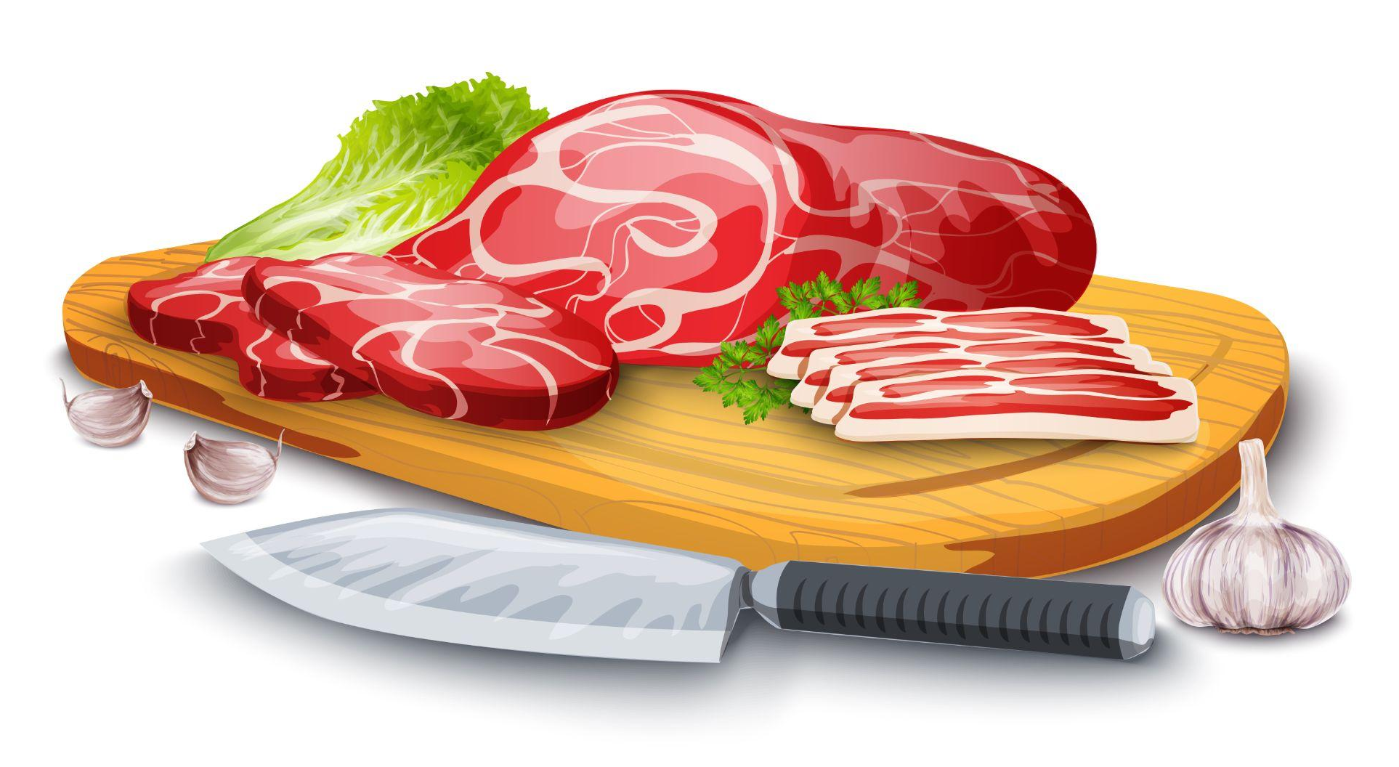
Key Recommendations: Separate
Separate to prevent cross contamination.
What is cross-contamination?
When one food item may cause contamination in other food item. For example, raw meat can contaminate a fruit/vegetable salad.
While keeping the food for chilling, care should be taken to store cooked foods in the top sections of the refrigerator. Uncooked foods can be stored at the bottom shelves.
Keep raw and ready-to-eat foods separate.
Keep raw meat and cooked food separate.

Slide 16
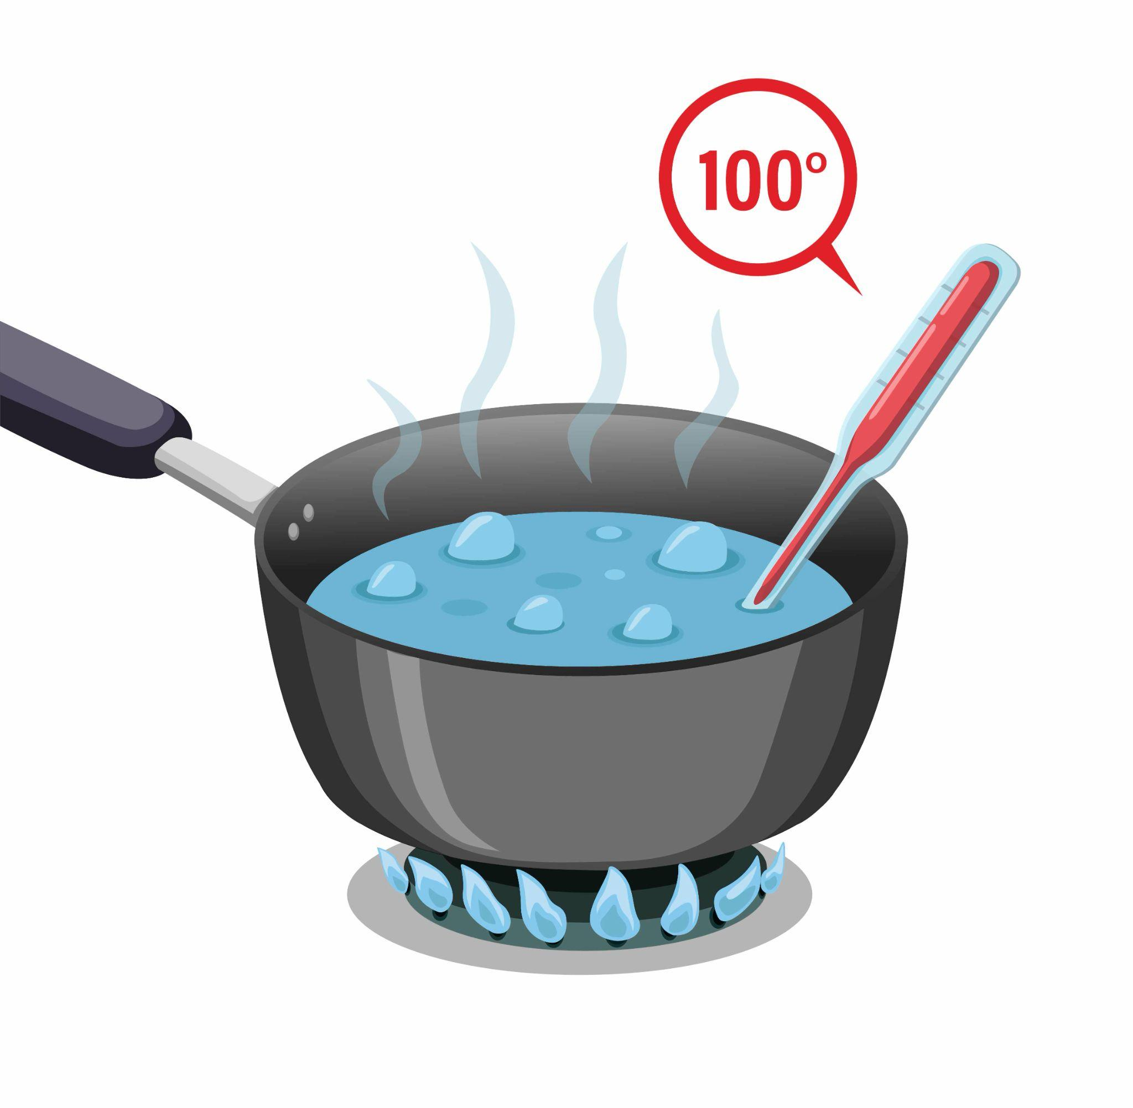
Key Recommendations: Cook
Harmful bacteria are destroyed when food is cooked to proper temperatures.
Licking or tasting food using the same spoon would contaminate the food item being prepared.

Slide 17

Key Recommendations: Chill
Refrigerate perishable food promptly to below 4°C.
Never keep a perishable food outside the refrigerator or freezer for more than 2 hours.
Regular refrigerator and freezer temperature checks are essential to food safety.
Meat or any other frozen food product should be kept for thawing in the refrigerator or the microwave.
The food item should never be kept on the countertop at room temperature for thawing purposes.

Slide 18
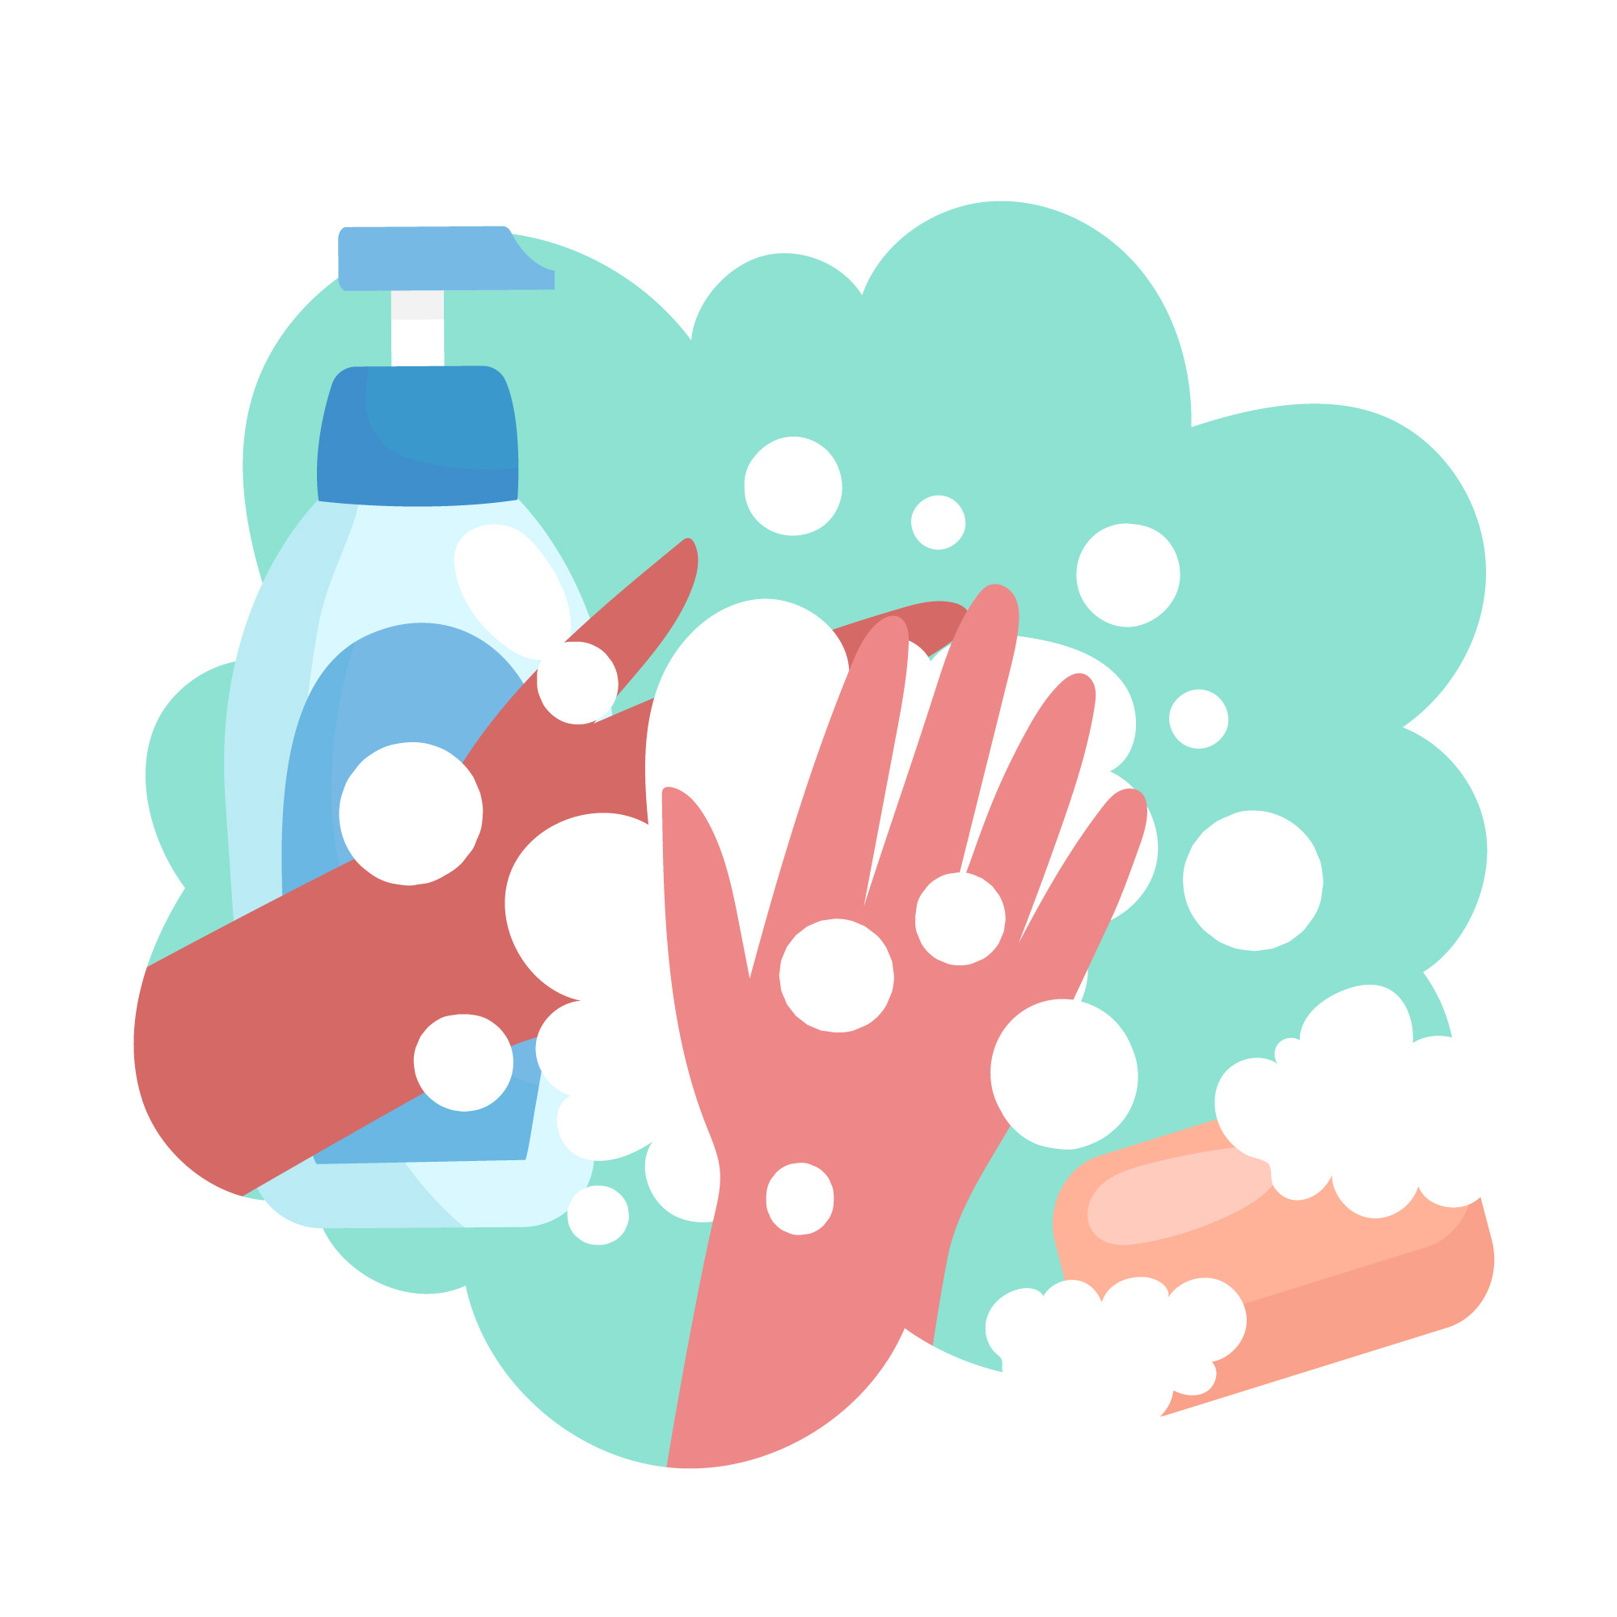
Key Recommendations: Clean
Wash hands often before and after you:
Prepare food
Eat or feed children
Handle raw foods
Use the restroom or change a diaper
Cough or sneeze
Handle garbage, dirty dishes, or cigarettes
Wash raw produce before cutting, cooking or eating
Wash utensils and cutting boards after each use
Keep kitchen surfaces clean
Dry your hands using disposable paper towels
Finger nails could be a source of contamination

Slide 19

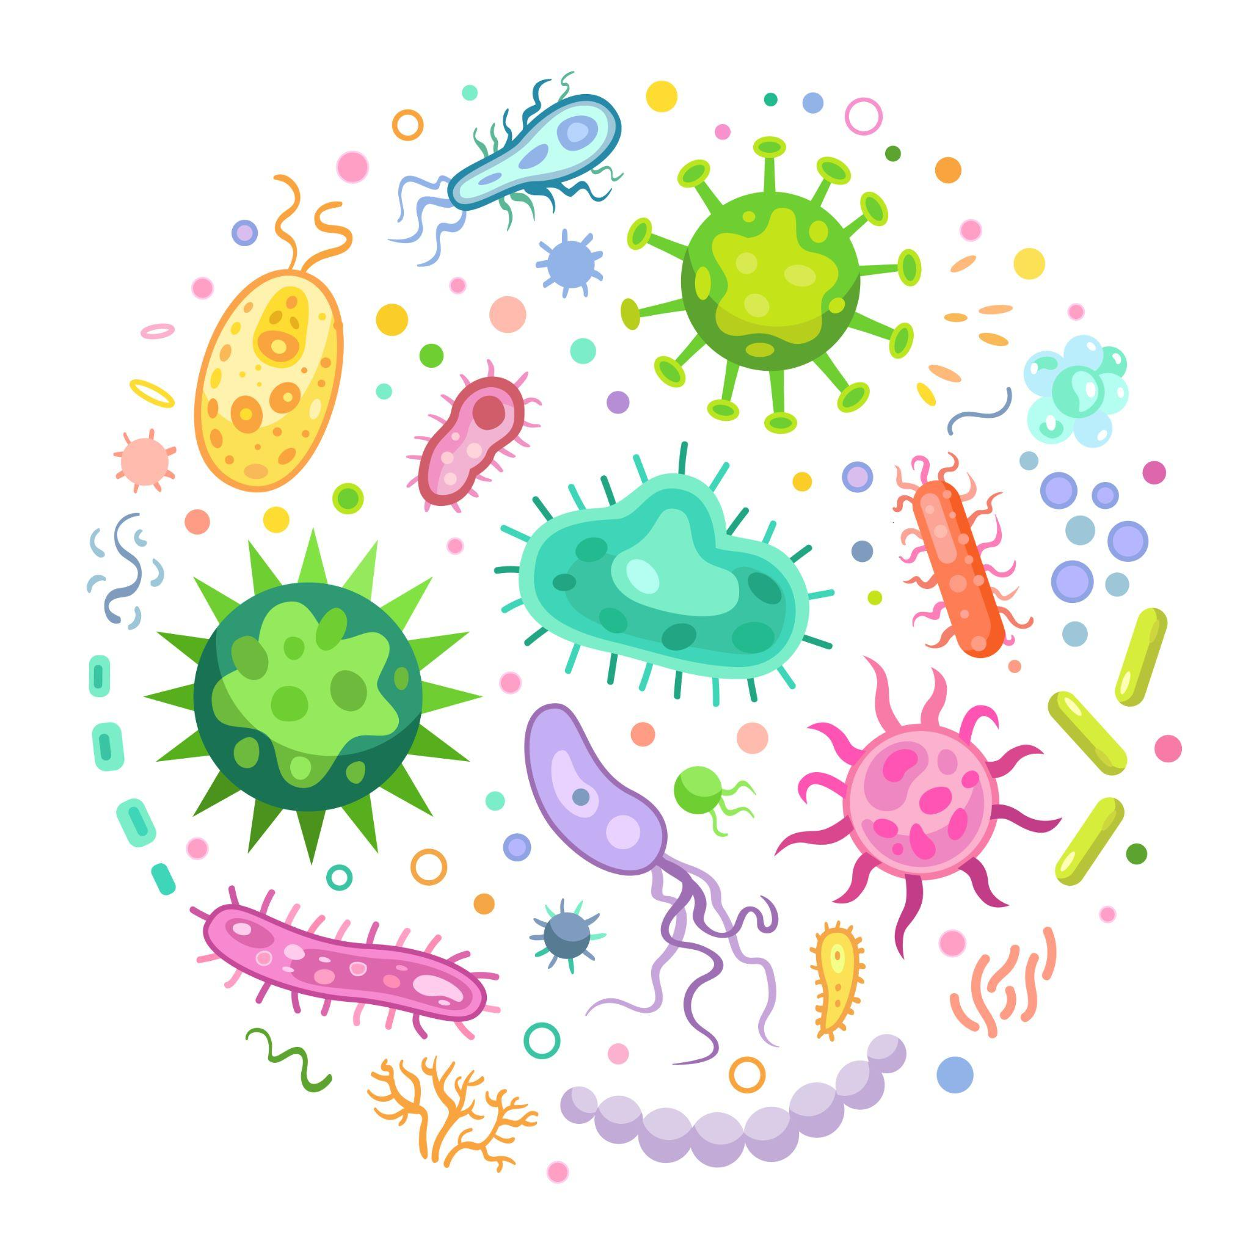
Key Recommendations: Clean
Sanitizers can quickly reduce the number of germs on hands in many situations.
However:
Sanitizers do not get rid of all types of germs.
Hand sanitizers may not be as effective when hands are visibly dirty or greasy.
Hand sanitizers might not remove harmful chemicals from hands like pesticides and heavy metals.

Slide 20
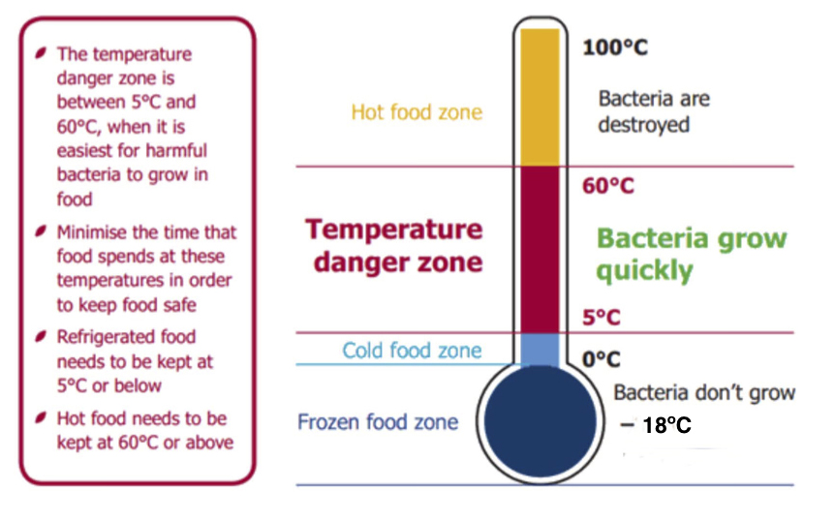
Temperature Danger Zone

Slide 21

Heating and Reheating Safely
Check that food is properly cooked.
When reheating, make sure the food is piping hot.
Only reheat the food once.

Slide 22
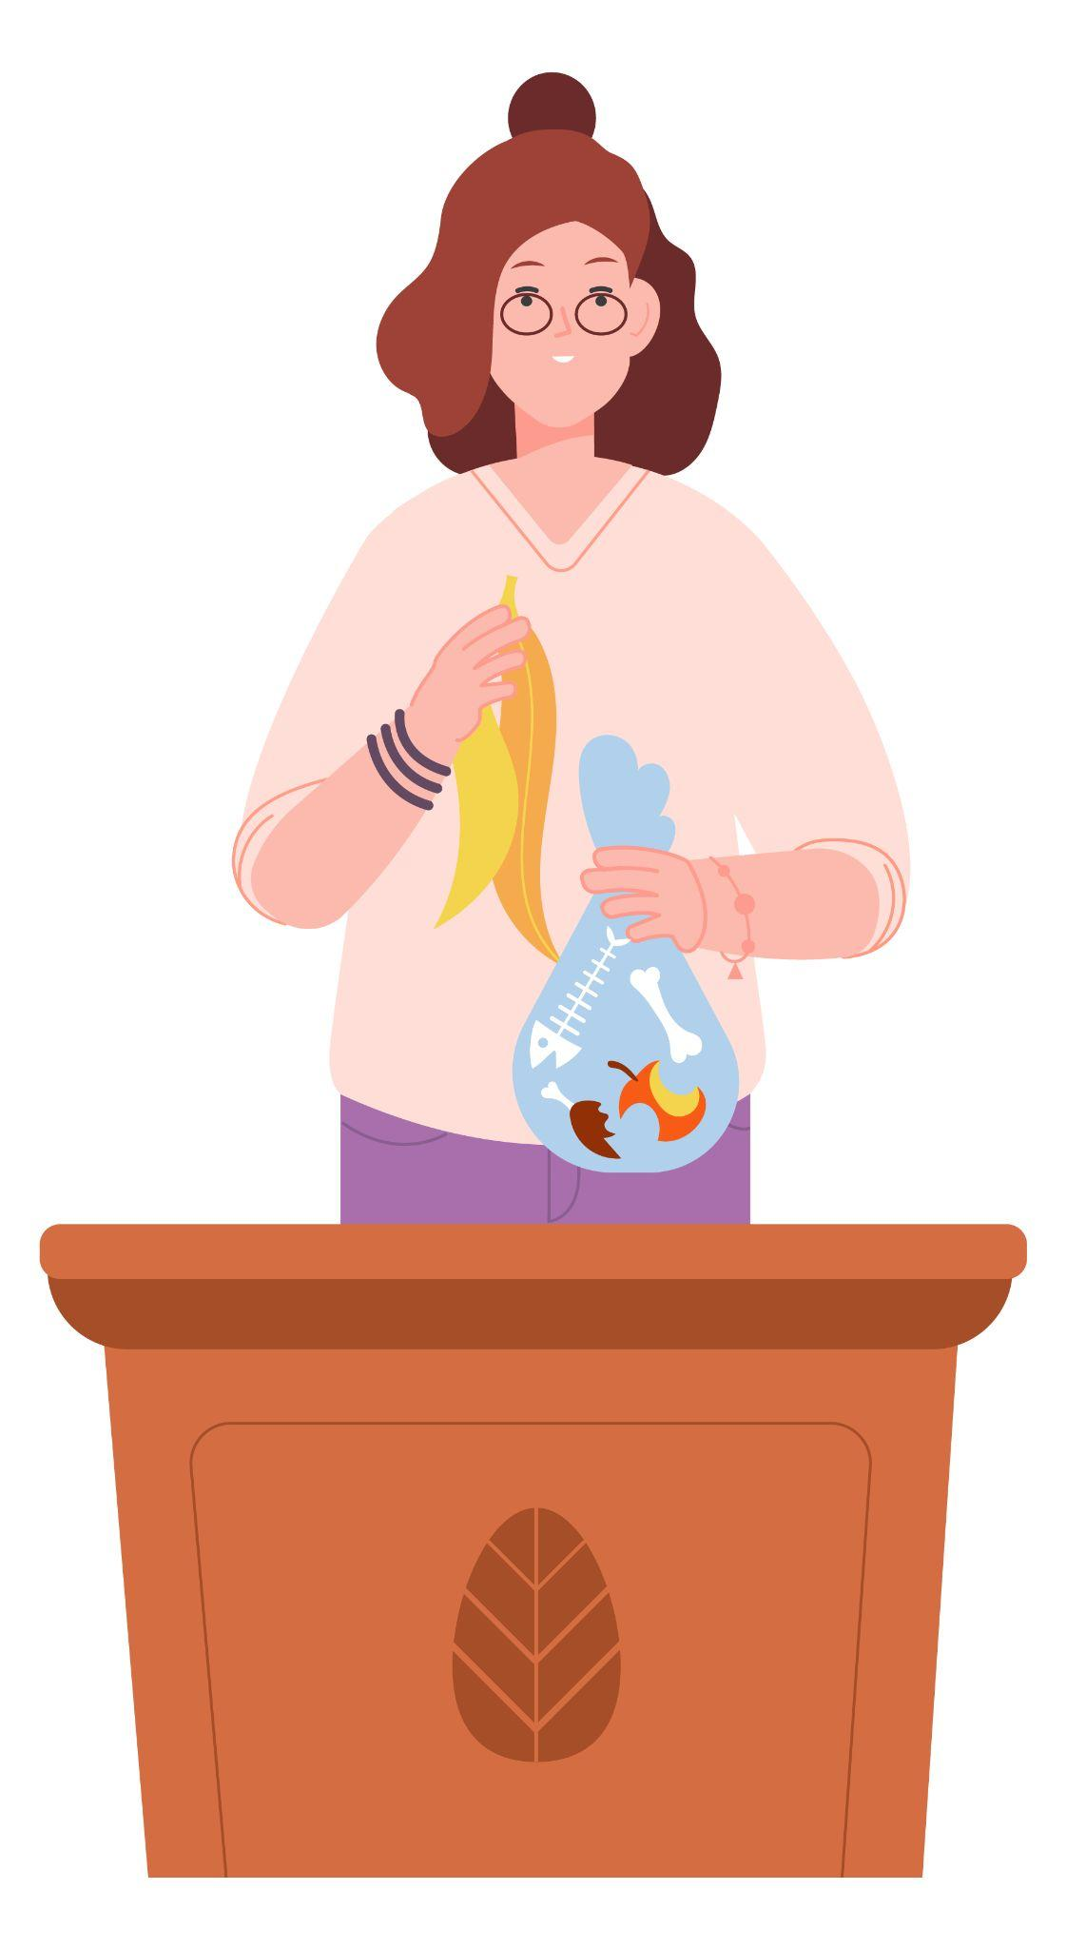
Waste
Make sure you have a bin nearby when you cook.
Collect food waste on newspaper or in a bowl on the table – place in the bin or compost after you have cooked.
Recycle used food packaging.

Slide 23
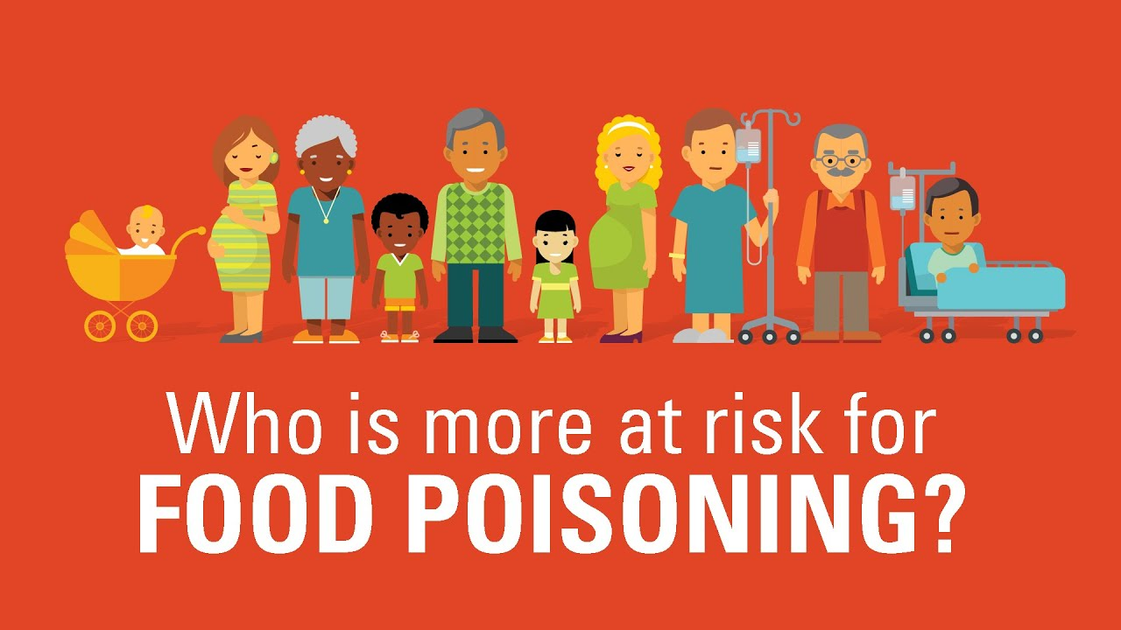
Key Recommendations for
Specific Populations
Populations at risk:
Infants, young children, pregnant women, older adults, and other people who have a low immunity should be very careful.
Avoid:
Raw (unpasteurized) milk or any products made from unpasteurized milk
Foods containing raw eggs
Raw or undercooked meat, poultry, and sushi
Unpasteurized juices
Deli and cold cuts of meat
*Only eat certain deli meats and frankfurters that have been reheated to steaming hot.

Slide 24

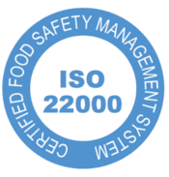

Food Safety Systems
There are various international systems that manage food safety hazards at the retail level/ industry:
HACCP: (Hazard Analysis Critical Control Point) The HACCP concept is designed to counter health hazards by identifying potential food safety problems before they happen.
ISO 22000: A proactive management plan for food safety relevant for any organization along the food supply chain.
GMP: (Good Manufacturing Practices) are internationally recognized quality assurance guidelines for the production of food, beverages, cosmetics, pharmaceuticals, dietary supplements and medical devices.

